Slide 1
DES (Data Encryption Standard) Algorithm
M Ahtesham Sarwar
2019-ag-6068
M Khawar Azeem
2019-ag-6067
Nabeel Ur Rehman
2019-ag-6078

Slide 2
iNTRODUCTION
Terms:
Encryption:
A process of encoding information.
Cryptography:
Cryptography is the practice and study of techniques for secure communication in the presence of malicious entity.
Symmetric-key Algorithm:
These are algorithms for cryptography that use the same cryptographic keys for both the encryption of plain-text and the decryption of ciphertext.

Slide 3
introduction
DES (DATA ENCRYPTION STANDARD) ALGORITHM:
The Data Encryption Standard (DES) is a symmetric-key algorithm for the encryption of digital data.
Developed in the early 1970s at IBM

Slide 4
drawbacks
DES Algorithm is insecure due to relatively short key size.
DES Algorithm is weakened against Brute-force attacks.
In January 1999, distributed.net and the Electronic Frontier Foundation collaborated to publicly break a DES key in 22 hours and15 minutes.

Slide 5
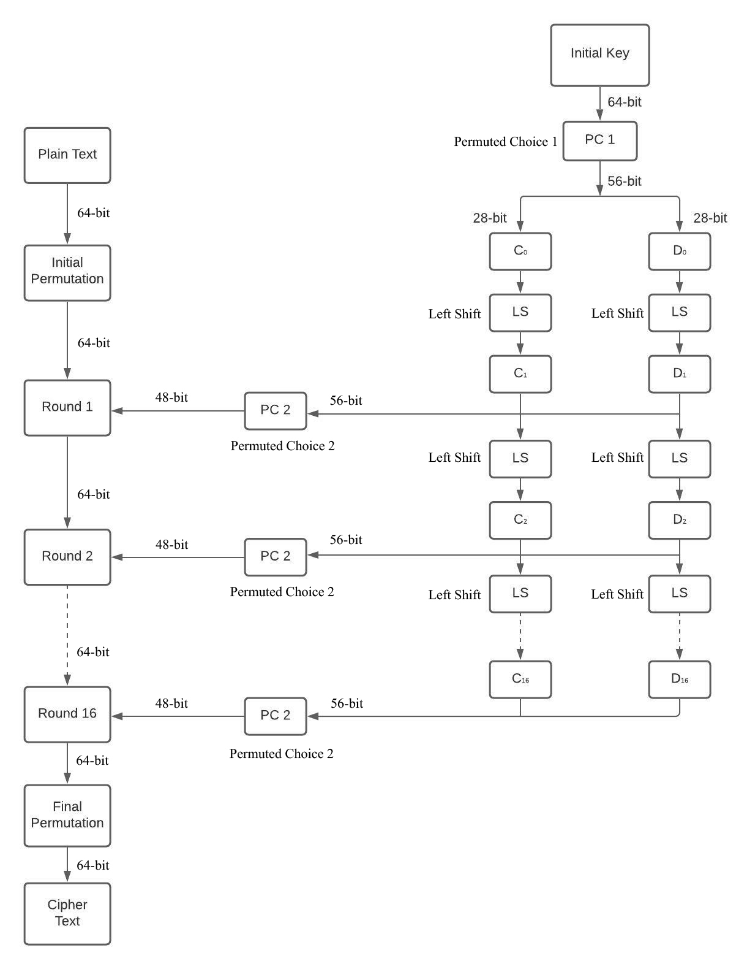

Slide 6
Algorithm Explanation
Input = A 64-Bit Plain Text (A text that a human can understand)
Output = A 64-Bit Cipher Text ( An encoded text that a human cannot understand)

Slide 7
Algorithm explanation
Steps of Algorithm:
In first step, a 64-bit plain text is sent for “Initial Permutation” Process.
Initial Permutation: In this process, rearranging of 64 bits of plain text is done.
In second step, rearranged 64-bit data is sent towards “Round” Process. There are total 16 Round Processes.
On the other hand, 48-bit sub-key is generated from 64-bit key.

Slide 8
Algorithm explanation
Following are the steps of the 48-bit sub-key generation process:
PC1 (Permuted Choice 1) :
A 64-bit key is given as input to PC1. This key contains 8 parity bits in it. At PC1, all these 8 parity bits of 64-bit are discarded and key is reduced to 56-bits.
After discarding 8 parity bits, all the 56 bits of key are rearranged.
After PC1, 56-bit key is divided into two equal 28-bit parts C0 and D0.
LS (Left Shift):
C0 and D0 are given as input to LS (Left Shift). LS will move the bits present in C0 and D0 by specified no. of bits towards left.
The number of bits by which the LS move the bits depend upon the Round No. If Round No is present in this group (1,2,9,16) then LS will shift the bits towards left by 1 bit. Otherwise, LS will shift the bits towards left by 2 bits.

Slide 9
Algorithm explanation
After LS, C0 and D0 will become C1 and D1.
C1 and D1 blocks joined and sent to PC2.
PC2 (Permutation Choice 2):
At PC2, 48-bits are selected from 56-bit key. After that 48-bit sub-key rearranged. This complete Process is called as Key Transformation or Compression Permutation Operation.
Why PC2 is called Compression Permutation Operation?
Because at PC2, 56-bit key is compressed into 48-bit sub-key.

Slide 10
Algorithm explanation
The output of one round will be used as input for following round until Round-16 is reached. The 48-bit sub-key generated from 56-bit key is different for each Round.
After processing of Round 16, the 64-bit output will sent to the “Final Permutation” Process.
Final Permutation:
In Final Permutation Process, the inverse of “Initial Permutation” will be done on 64-bit data.
Both Final Permutation Process and Initial Permutation process are inverse of each other.
The functionality of “Round” process is the core of DES Algorithm.

Slide 11
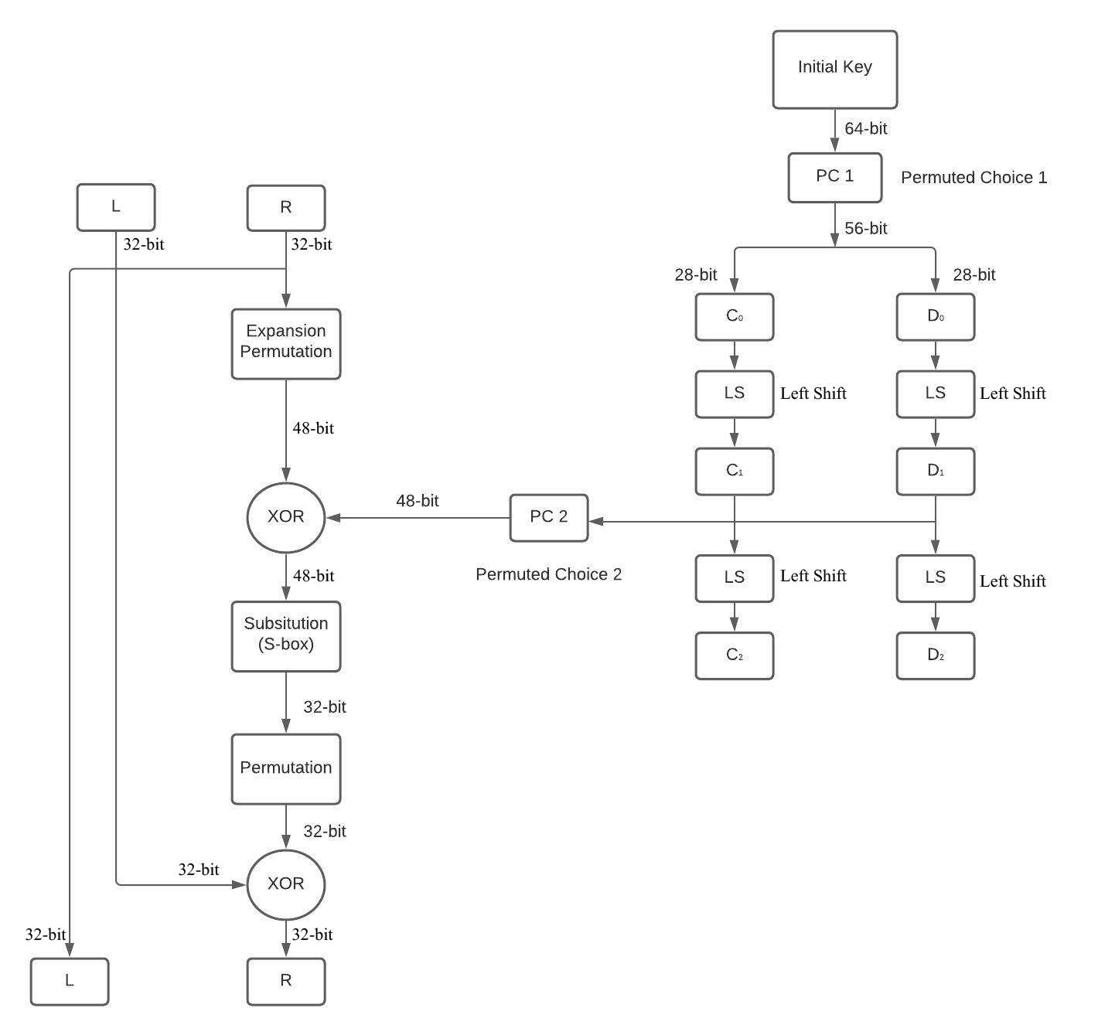

Slide 12
Algorithm explanation
After “Initial Permutation” Process, data will be divided into two parts (L and R) each of 32-bit.
Expansion Permutation:
32-bit data of R Block is given as input to Expansion Permutation Process. In this process, the 32-bit data is expanded into 48-bit data by adding 16 bits into 32-bit data. After expanding, all the bits of data will be rearranged.
After expansion Permutation process, XOR operation is done on 48-bit data.
XOR:
It returns true if and only if the operands are different. It returns false if and only if the operands are same.

Slide 13
Algorithm explanation
After XOR operation on 48-bit data, the data is given as input to the Substitution (S-Box).
Substitution (S-Box):
Basic Component of Symmetric Algorithms
Used for Substitutions
In this process, 48-bit data will be converted into 32-bit data.
Total No. of S-Box are 8.
Each S-Box will get 6 bits and convert them into 4 bits.
S-Box is a table containing 4 rows and 16 columns.
The first and last bit of input given to S-Box will be used to determine the Row No. in S-Box table.
The remaining4 bits are used to determine the Column no of S-Box table.

Slide 14
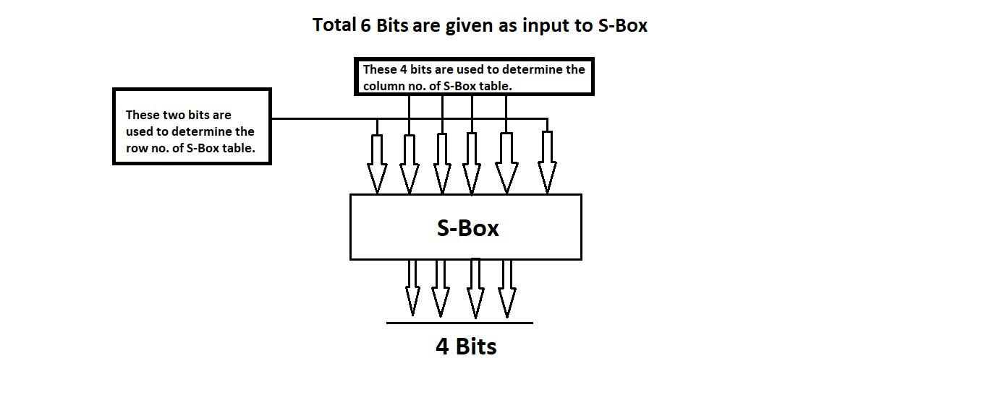
Algorithm explanation

Slide 15
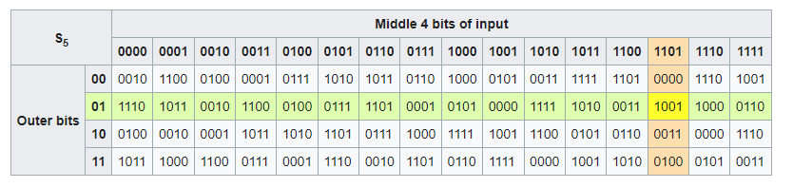
Algorithm explanation

Slide 16
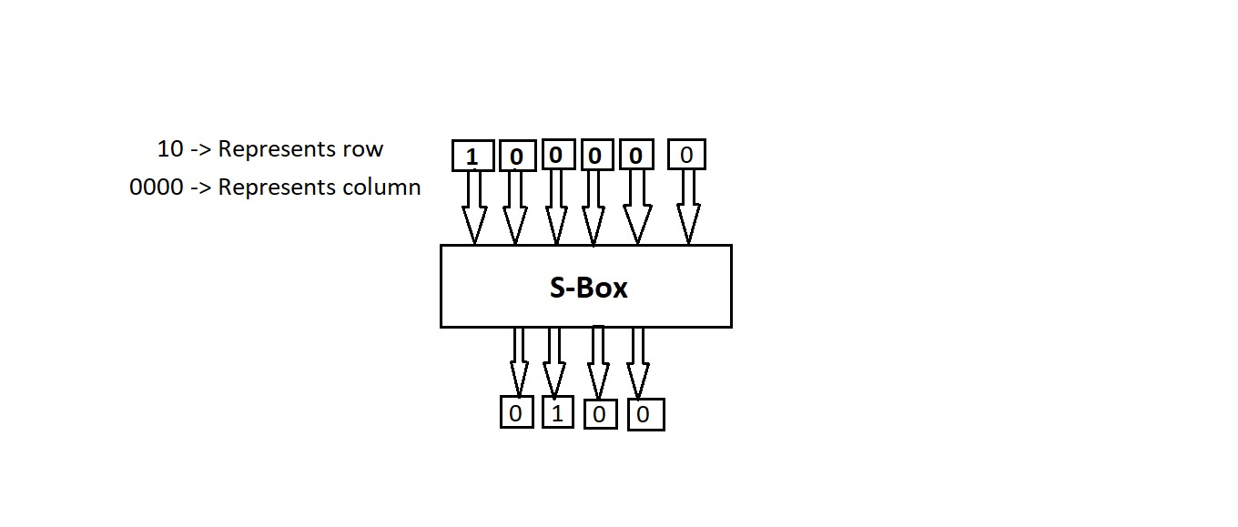
Algorithm explanation

Slide 17
Algorithm explanation
After the processing of Round-16, we will get two 32-bit parts of data (L and R), both of the parts will be swapped and then 64-bit data will be sent to “Final Permutation” process.

Slide 18
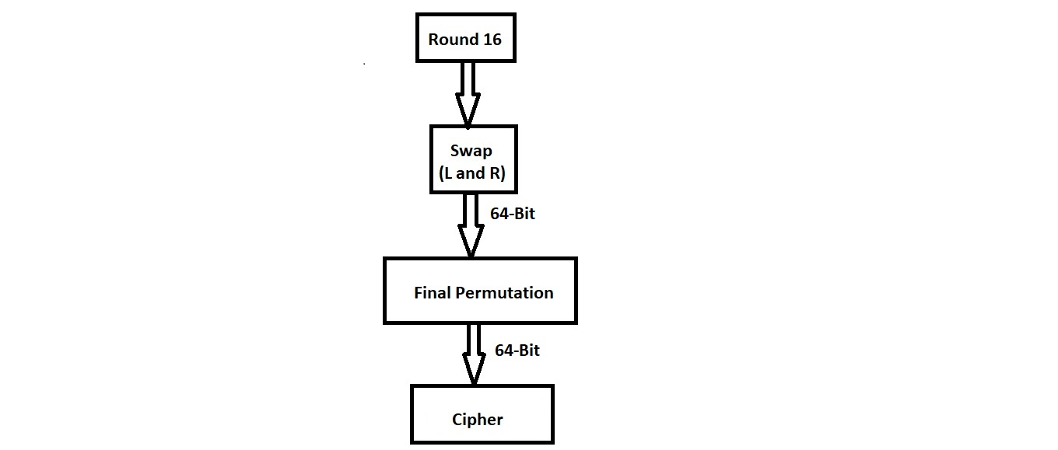
Algorithm explanation

